Slide 1

Lecture 3.1
Introduction to Relational Databases
Notes:
Welcome to this lecture in the SQL Chapter. In this first lecture of the course chapter, we are going to do an introduction of databases and relational databases.

Slide 2

A G E N D A
Introduction of the Chapter
Intro to Databases
Building First Database with Excel
The Need for an Professional Database
Different Types of Databases
Interacting with Databases
What is PostgreSQL?
Database for the Chapter
Notes:
But before that, let’s talk about the agenda of chapter 1. We will start by doing a course introduction, follow by an introduction to databases. Then you will get chance in building you first database with Excel. After that, we are going to discuss why do we need to use the professional databases as well as the different types of databases. Before we wrap up this chapter, we are going to talk about how to interact with databases and the database software that we are going to use throughout the course.

Slide 3
Introduction of the Chapter
Notes:
Without further adieu, Let’s look at the course introduction so that you will know what you are going to learn.

Slide 4

Chapter Objectives
✅ Get to operate a wide range of SQL database, in particular SQLite
✅ Basic proficiencies in SQL query language
✅ SQL aggregation using GROUP BY statement
✅ Advanced queries with logics and various functions
✅ Identify primary keys and foreign keys
✅ SQL JOINs to combine tables with different dimensions
Notes:
In this course, we are going to teach you in operating a wide range of SQL databases, and build your proficiencies in SQL query languages.
You will also get change to write advanced SQL queries with logics, various functions, aggregations and GROUP BY statement.
We will also cover table relationships by using primary keys and foreign keys, as well as using SQL joins to combine tables with different dimensions. We will also learn to manage SQL tables using SQL statements.
Before we end this course, we will learn to draw ERD Diagram to visualize SQL table linkages and database architecture.
So now you are clear that what you are going to learn in this course. Let’s jump on to the next video to start learning about databases

Slide 5
Database 101
Notes:
In this session, we are going to give u an overview of databases and why do you need it.

Slide 6

What is Database?
A database is a collection of information that is organized so that it can be easily accessed, managed and updated. Computer databases typically contain aggregations of data records or files, containing information about sales transactions or interactions with specific customers.
-- Whatis.com
Notes:
Let’s first look at the definition from whatis.com:
A database is a collection of organized information so that it can be easily accessed, managed and updated.
So basically, any methods that you are using to store and organize data could be considered as a database, including an excel file, a stack of 3M memo notes, a physical notebook, a Microsoft Word document, or even a folder on your computer. As long as it is being used to store and retrieve data, then it could be consider as a database.

Slide 7
Elements of a SYSTEM
Database
Input
Process
Output
Notes:
Now we know what are databases, let’s take a quick look in where a database sits in a computer system. A typical computer system consists of 3 parts, input, process and output. Take Facebook App as an example, the input is the user actions like clicking, scrolling, and the process is the facebook app. The output is the content that you are reading on Facebook.
Usually the process would be connecting to a database for pulling and storing data. Every time when there are user actions like clicking or scrolling, the facebook app will go to the database to pull the relevant content and display as an output.

Slide 8
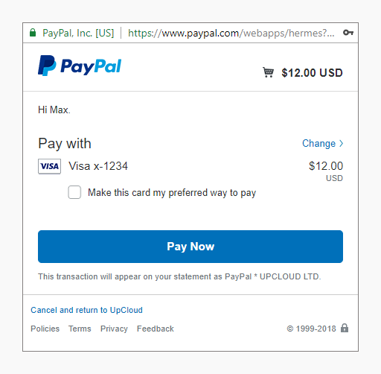

Which Applications use Database?
Notes:
You might wonder what are the applications that would use databases. The fact is, probably 99% of the computer softwares, apps, and web pages are connecting to at least one databases for storing and retrieving data. For example, Paypal leverage databases to store your transaction records and Twitter use databases to store all the tweets and likes.

Slide 9




Why Do We Need Databases?
User
Status
User
History
User
Data
Website
Content
Notes:
So the next question is - what are the data being stored on a database?
There are 4 main types of data on a databases, including user status, user history, user data and website content.
Take Facebook as an example again, user status is the storing whether you are online or offline at the moment. User history is all your historic interactions on facebook, including what are the posts that you have clicked, read, or left comment with.
User data would be your personal profile, like your name, gender, education, age and all other personal information that you uploaded on Facebook.
And lastly, website or app content refers to the information that you are reading on the website or app. In the case of facebook, of course those content are facebook articles and posts.
Hopefully you should have a high level overview of database and the purposes of databases now. See you in the next video.

Slide 10
Building our First Database with Excel
Notes:
Now that we have learned about the database concept. In the part, we are going to build our first database with Excel.

Slide 11

Imagine we are Facebook...
User Profile
Name
Age
School
City
Interest
Have Friends
Notes:
Before we actually building the database, we will first need to design the database.
Let’s imagine we are Facebook. Users create their user profiles to connect with their friends. When a user creates a user profile, they need to include some of the basic information, such as name, age, school or education history, city, and other interests that they may have. Each of the profile is connected to a number of other user profiles as “facebook friends”.

Slide 12

Imagine we are Facebook...
User Profile
Name
Age
School
City
Interest
Post
Post Title
Post Content
Have
Have Friends
Notes:
After they create a profile, they typically create a post. It is not must for everyone, but if a user is creating a post, then the post would include a post title and some content.
So we will need to also store this post content to database when the user publish the post.

Slide 13

Imagine we are Facebook...
Likes
User
(User Profile)
Like Time
User Profile
Name
Age
School
City
Interest
Post
Post Title
Post Content
Have
Have Friends
Notes:
Once a user published a post, then all his/her friends would be seeing the post. Some of them might like the post by clicking the like button. Facebook database would also need to store this piece of information including who liked it, and when.

Slide 14
Imagine we are Facebook...
Likes
User
(User Profile)
Like Time
User Profile
Name
Age
School
City
Interest
Post
Post Title
Post Content
Have
Comments
User
(User Profile)
Content
Have
Have Friends
Notes:
Apart from likes, people would also leave comments on a facebook post. Of course facebook databases will need to capture this piece of information. So you would probably know - we need to store who commented on the post, and the comment itself.

Slide 15
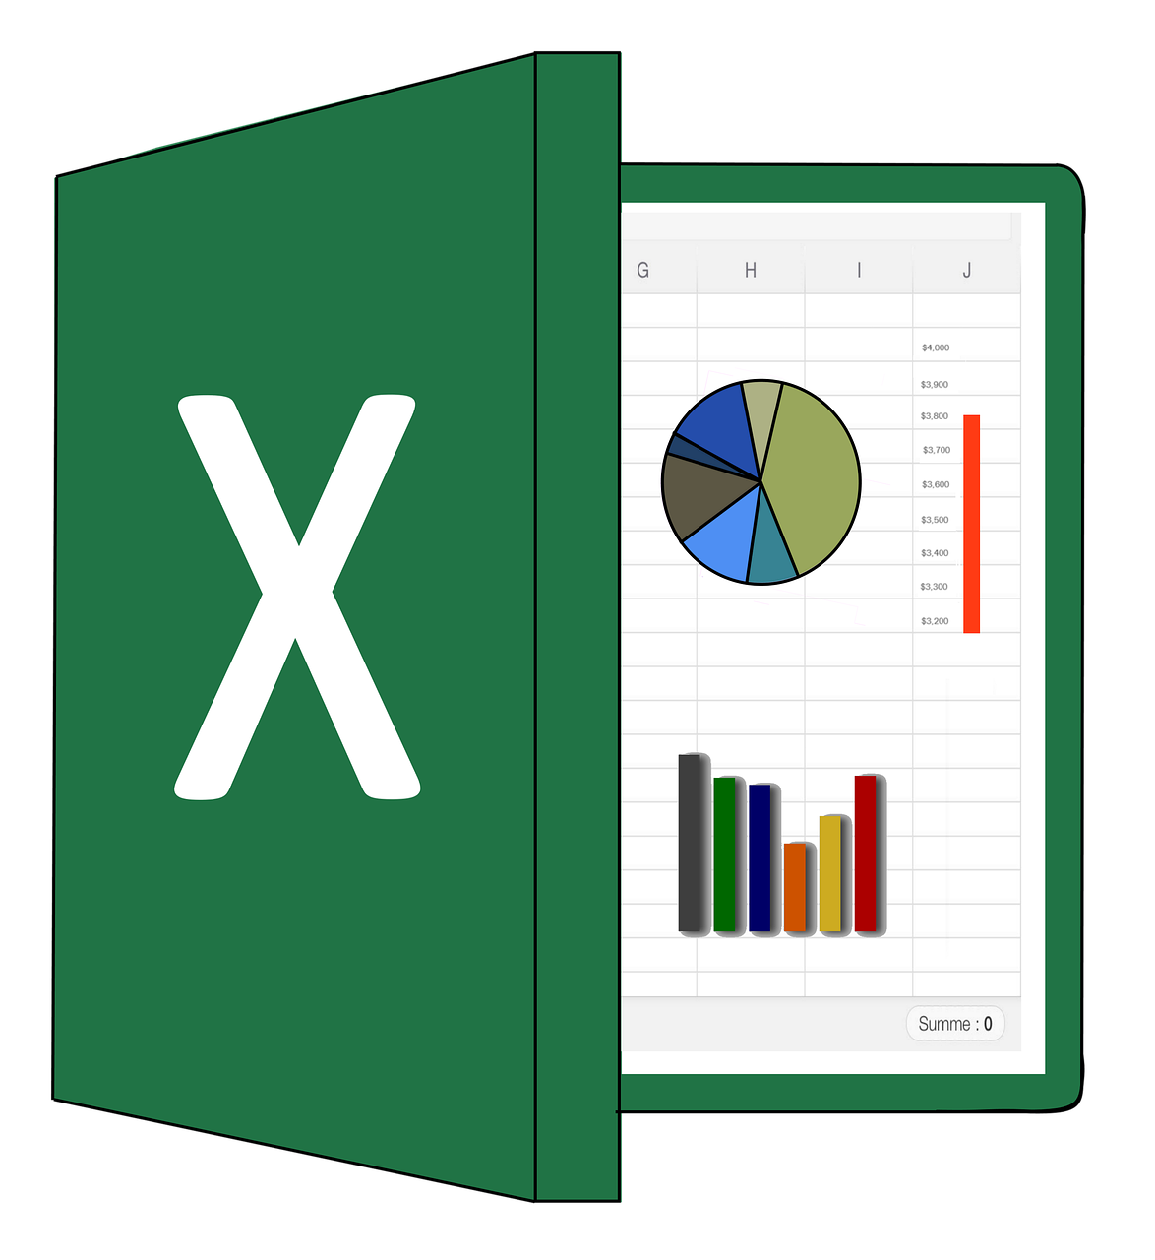
Let’s get STARTED with Excel!
Building a Facebook Database with Excel!
Three important concepts:
Table - Represent a physical concept
Column/Field - Represent a property
Row - Represent a record
Notes:
Speaker notes:
Before we start building a database with excel, let’s learn about a few database concepts first. They are Table, column and rows. Actually, these concept are the same for most of the databases.
Table represent a physical concept, for example, you can have a car table which store all the car information in the city. For talentlabs, we have a students table in our database to store all the students’ information. You can consider a table as a category of data.
Column represent different properties of the physical object. For example, for the car table, we will have columns like “brand” of the car, “model” of the car, “price” of the car, “max speed” of the car etc as table columns.
The last concept for a database is row. Each row in the table represents one record. For example, if I have 10 students in my students table, then there should be 10 rows in my table.
These concepts should be pretty simple and intuitive for most of the people, as we have all used tables in our day to day life. There are nothing special for database table and the table that we use in our day to day life.
-----------
For this page, we are expecting the instructor to use Excel to build a database to understand the concept of tables.
Create the demo on Excel. Perform some of the listed tasks on the slide.

Slide 16
Imagine we are Facebook...
🤔 The data is too complex to just write into Excel
🏢 We have to store the data somewhere - every user’s hard drive?
⚙️ There must be a system to manage the data
Notes:
Now imagine you are facebook:
Would you use Excel as a database? Probably not. There are just too many data to be stored and Excel is not very user friendly in handling complex data of this scale. Also, we cannot just store the data in an excel file as it’s not possible to share the excel file with everyone in real time. And not to mention that there is a maximum number of rows in Excel and it is not enough for storing all the facebook data.
That’s why we need to use some professional database system to store application data in a scalable and reliable way.

Slide 17
The Need for a Professional Database
Notes:
In the previous section, we mentioned that we will need to use some professional database system to store application data. We are going to discuss this in details.

Slide 18
Excel as Database? Great START, but...
❌ Too easy to make changes
❌ Hard to keep track of changes
❌ Cannot be accessed by multiple people at the same time
❌ Limited row count - 1,048,576 rows (for xlsx file)
❌ Cannot locate a single record easily
❌ Cannot create summary to large amount of data easily
Notes:
So, we have just built an Excel database for Facebook users. Even though most of the information about the users was there, it was not easy to manage. As the Excel file size grows, it becomes difficult to manage it. You also have difficulty in making changes – well, you can make the changes, but then you need to figure out how to manage conflicts and different versions of the same file.
We will face other challenges like sharing the information in Excel with other users. Excel is not like Google Sheets or Microsoft OneDrive, it may not be easy for all of the users to make changes at the same. Even with online editing technologies, the file gets locked out if you are editing a field and someone else tries to edit the same field.
Then, there is a row limitation. In Excel, there are a maximum of 1 million records per worksheet. After that, you cannot add more records to the same worksheet but facebook got billions of users.
Finding a record is another challenge. What if there are 10 users with the same name. Locating the correct user in the file becomes difficult. We will have to apply several filters to get the correct data. For example, we may have to filter by name, then age and maybe city.
What if you need to create a summary or perform some analysis? Even though Excel provides analysis tools, but they have limited functionality. We may not get the desired results.
Now that we know all these problems, what is the solution? We need something that is more dynamic and provide solutions to all these problems that we have just discussed. So what are the features a professional databases should include?

Slide 19

Additional Database Features
➕ Backup Mechanisms
➕ Simultaneous Connections
➕ Data Integrity Features
➕ Scalability
➕ Speed
Notes:
Other than just storing and retrieving data, a professional database should be equipped with features, such as:
➕ Backup Mechanisms
➕ Simultaneous Connections
➕ Data Integrity Features
➕ Scalability
➕ Speed (Optimize the memory architecture)
Most modern professional database applications have these features. For example, automatically backup is a basic feature nowadays. Similarly, there are data integrity features to ensure the data are intact. Most of these are advanced database administrator skills and we will leave it for advanced database courses. We will focus on SQL queries in this course.

Slide 20
Different Types of Databases
Notes:
By now, we should all know that we need a professional database. In this section, we will discuss the different types of professional databases.

Slide 21
Types of Databases
For professional databases, there are two main types:
SQL
(Relational Database)
NoSQL
(Document Store)
Focus of this course: Relational Database/SQL
Notes:
When we are talking about professional databases, there are two types of databases, SQL and NoSQL.
SQL databases is also refers to relational database that is designed to store structured data. That means you need to define tables, columns and rows. you cannot just random add rows or store random data in the database without setting up the data structure first.
On the other hand, NoSQL is a document store that stores unstructured data, that means the data are not organized in table format. Data could be organized as spider web-like network, folders and any innovative ways of storing data. Basically any structure that’s not a table. They CANNOT be accessed or managed by using SQL tools and softwares.
Now, the question is which one should we choose. There is no concrete answer. The choice is dependent on the business requirements and needs that we may have. Both types can have their own advantages and disadvantages. As you have more practical experiences with both, you will have more idea in picking between the two main types of databases.
In this course, we will be focusing on SQL databases.

Slide 22
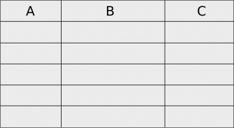

Relational Databases/SQL
A relational database has a clear data structure (in tables, rows, and columns)
Each table on the database can be linked to each other
Example: On Facebook, a “Post” table can be linked to a “Like” table as “posts can have likes”
SQL queries can retrieve or summarize data from tables
👍🏼
Notes:
When we refer to the relational databases, we need to have structured data, which means that the data should have certain fields or columns and should be stored in rows. Each row represents an individual record within the database. In relational databases, a table can be linked with the other tables within a database to represent relationships. For example, in the previous chapter, we saw there is a table for users, one for posts, and another one for comments. All these were linked with each other by using ids. We will discuss how to link tables in a dedicated chapter.
After we store the data in a SQL database, we need to retrieve it when we want to use the data. This could be done by using SQL queries, a special programming language for SQL databases.
We also use SQL queries to make changes to a database. Whether we are adding the information or deleting it or updating it. SQL syntaxes are mostly the same across different relational databases, so once you learn how to write SQL queries on one relational database, and later you can apply your knowledge in other relational databases.

Slide 23




Examples of Relational Databases
SQL DB (Relational DB)
Notes:
In reality, there are many different SQL or relational databases. They all work similarly and can be query by using a similar SQL language.
sql : mysql, Microsoft SQL Server, postgresql, SQLite and more
All of them have their own good and bad and usually we will need to do some research when we pick from the list. Don’t worry about that for now, we have helped you in picking the easiest one for this course.

Slide 24
Interacting with Databases
Notes:
In this section, we are going to talk about how an application interact with a database.

Slide 25
Role of a Database
A database is both
data storage space, and
interface to pull/query the data
Applications (e.g. apps, web pages) talk to the database to pull data
Once the data is retrieved, the data is then displayed in the user interfaces (e.g. apps, web pages)
Applications
Database
Notes:
First, we need to understand that a database is both a data storage space and an interface to pull or query the data. Applications like mobile apps, web pages would talk to the database in pulling data or saving data.
All data related operations are sent to the database as SQL queries. When the database receives a SQL query command, it would follow the instruction to retrieve data or make changes to data. For example, when we open our profile in Facebook, the app would fetch information from the database using SQL queries, and display in the app. This is how we get to see our information in an app or website.

Slide 26
Role of an Application
Applications
Apart from retrieving data, an application can also creates/updates user records according to some business logic
Application will send instructions to the database and database will store the data accordingly
Database
Notes:
Apart from retrieving data, an application can also creates or updates user records according to some business logic. You can leverage the facebook app to create, update, delete, or retrieve information in the facebook database. Again, this is done by SQL queries.
For example, when you add a post in Facebook, the SQL queries are triggered to add the post to the database in the backend by sending a SQL query. The database will then follow the SQL queries instruction to save the post in the database. This might sound very complex at this moment, but we will learn more about this when we get to the SQL queries.

Slide 27
Accessing a Database
Using Database clients - web interface or application-based
(a software)
Using programming interfaces
(a program)
Using command line
(seldomly used)
Notes:
So apart from using an app to interact with a database, what are the other methods? There are 3 different methods.
The first method is going through the database clients, which can be a Web interface or a piece of software you install on your computer. This would be the major way of interacting with databases in this course.
We can also access the database using programming interfaces. Most of the mobile apps are using programming interfaces to interact with the database. You will learn more about this if you are going to become a software engineer.
The last and rarely used method is that we can use the commands in a terminal, those black and white terminal where you always see in movies.
So now you know how to interact with a database. Let’s move on to the next video.

Slide 28
Database for this Chapter
Notes:
In this section, we are going to introduce with you the database software that we are going to use throughout this course

Slide 29
We’ll be using SQLite!
Notes:
We mentioned that there are multiple relational databases that we can choose. In this course, we will be using SQLite as our database software. It is a super lightweight database software and got a couple benefits for beginners.

Slide 30

Why SQLite?
Run locally as a embedded database
No installation is needed
Other SQL databases require a server to run on (Complicated setup)
Can be embedded into a program
WhatsApp chat history is maintained on a SQLite database on your mobile phone!
We will walk through the database setup in the next chapter
Notes:
First of all, it can be run locally as a embedded database, which means that no installation required and therefore, the you do not have to perform a complicated setup like the other SQL databases. You can start by downloading a database file and no complicated server setup is needed.
We mentioned that SQLite database is an embedded database. That means that it could be embedded into a app or software. One example of this would be WhatsApp, which stores the the conversions using SQLite database on the your mobile phone. So later on, if you want to build your own databases for your day-to-day applications, it would be super easy.
We will learn about the environment setup of SQLite in the next chapter so you can directly practice your SQL skills. This is the end of chapter 1 and I hope you have a good understanding of relational databases now.

